Slide 1

Gold Price
Prediction

Slide 2
1
Problem Statement
This project aims to analyze and predict daily gold prices using a comprehensive dataset from Nasdaq, covering January 19, 2014, to January 22, 2024.
The goal is to develop predictive models, formulate trading strategies, and assess market sentiment's impact on gold price movements.

Slide 3
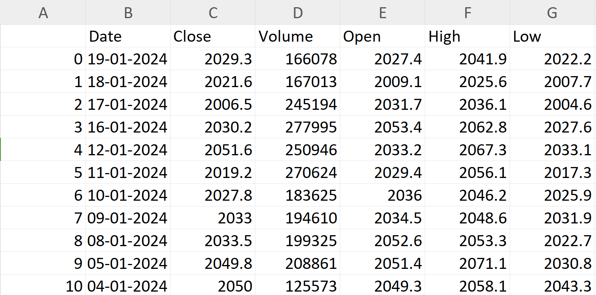
Dataset
2
Dataset Description:
1. Date: A unique identifier for each trading day.
2. Close: Closing price of gold on the respective date.
3. Volume: Gold trading volume on the corresponding date.
4. Open: Opening price of gold on the respective date.
5. High: The highest recorded price of gold during
the trading day.
6. Low: The lowest price recorded for gold in the
trading day.

Slide 4
3
STEPS
1
Exploratory
Data Analysis
4
Advanced
Modeling
2
Data Visualization
& Preprocessing
5
Trading Strategy
Development
3
Time Series
Analysis
6
Statistical
Analysis

Slide 5
THANK YOU

